Slide 1


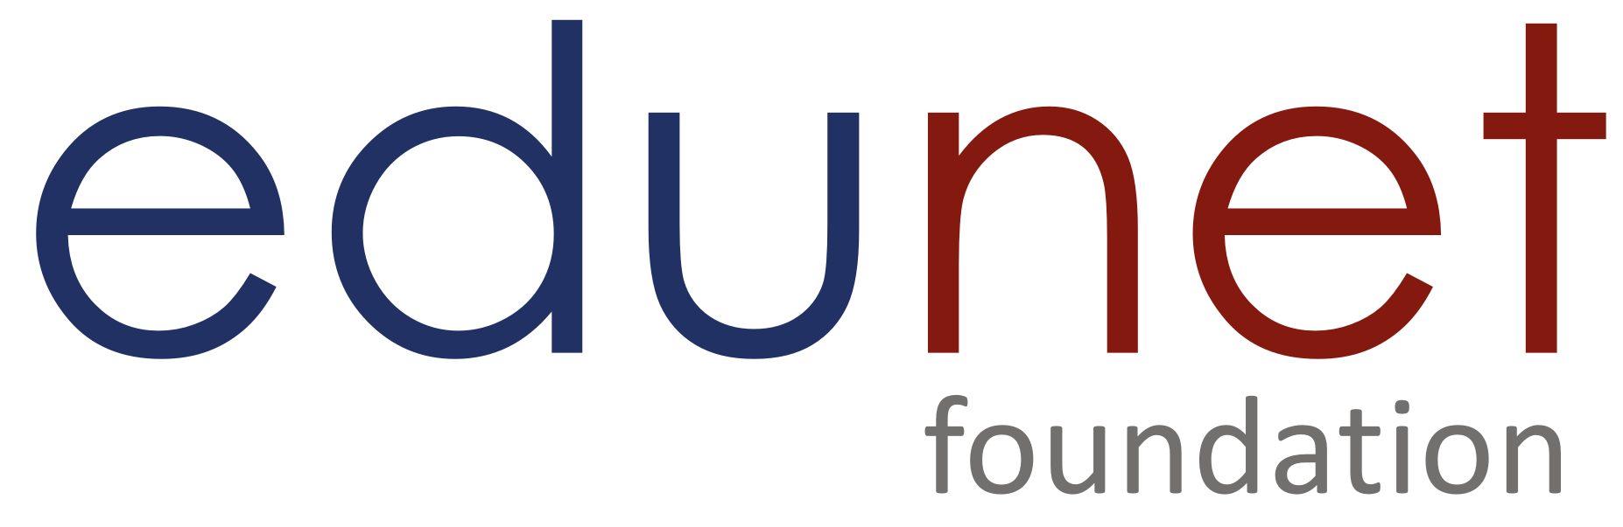

NEXT GEN EMPLOYABILITY PROGRAM
Creating a future-ready workforce
Team Members
College Name
Student Name : HEERA C
Student ID : au814721104023
SRM TRP ENGINEERING COLLEGE

Slide 2

CAPSTONE PROJECT SHOWCASE
Project Title
Notes Sharing Web Application using Django Framework
Abstract | Problem Statement | Project Overview | Proposed Solution | Technology Used | Modelling & Results | Conclusion

Slide 3
Abstract
In today's digital era, efficient collaboration and information sharing are crucial for productivity and innovation. This project aims to develop a Notes Sharing Web Application using the Django Framework, a powerful tool for building web applications in Python. The application facilitates users to create, organize, and share notes seamlessly with collaborators.
Key features of the application include user authentication, allowing users to register, log in, and manage their accounts securely. Once logged in, users can create notes with rich text formatting options, including bold, italic, bullet points, etc. The application provides a user-friendly interface for organizing notes into categories or folders for better management.
One of the core functionalities is the ability to share notes with other users. Users can invite collaborators by specifying their usernames or email addresses, granting them either read-only or editing access to the shared notes. Real-time collaborative editing is facilitated through WebSocket communication, enabling multiple users to work on the same note simultaneously.
Additionally, the application offers features for version control and revision history, allowing users to track changes made to notes over time and revert to previous versions if needed. Advanced search functionality enables users to quickly find specific notes based on keywords or tags.

Slide 4
Problem Statement
In the fast-paced digital world, individuals and teams often struggle with inefficient note-taking and collaboration methods. Traditional methods like handwritten notes or scattered digital documents lack organization, version control, and real-time collaboration capabilities, leading to productivity bottlenecks and information silos.
Existing note-taking applications often lack robust collaboration features or are cumbersome to use, hindering effective teamwork and knowledge sharing. Additionally, concerns about data privacy and security persist, especially when sharing sensitive information across multiple users.
To address these challenges, there is a need for a comprehensive Notes Sharing Web Application that offers seamless collaboration, organization, version control, and security features. This application should provide users with a user-friendly interface for creating, editing, organizing, and sharing notes, while ensuring data privacy and security.

Slide 5
Project Overview
The Notes Sharing Web Application using Django Framework is a comprehensive platform designed to streamline note-taking and collaboration processes for individuals and teams. Built upon the Django web framework, the application offers a user-friendly interface coupled with robust features to enhance productivity and facilitate seamless teamwork.
The Notes Sharing Web Application using Django Framework provides a comprehensive solution for efficient note-taking and collaboration. By leveraging Django's features and incorporating advanced functionalities, the application aims to enhance productivity, foster teamwork, and facilitate knowledge sharing among users.
Key components of the application include:
* User Authentication
* Note Creation and Editing
* Organization and Management
* Collaborative Editing

Slide 6
Proposed Solution
.
The proposed solution is a Notes Sharing Web Application built on the Django Framework, designed to revolutionize note-taking and collaboration processes. It begins with user registration and authentication, ensuring secure access for registered users while safeguarding their credentials with encryption techniques. Once logged in, users are empowered with a feature-rich text editor to create and edit notes effortlessly, embellished with formatting options like bold, italic, bullet points, and hyperlinks. The platform emphasizes organization, allowing users to categorize their notes into folders for streamlined management. Collaborative editing is a key feature, enabling real-time collaboration among multiple users on the same note, with customizable access controls ensuring privacy and workflow integrity. Version control mechanisms keep track of note revisions, empowering users to review and revert changes as needed. An advanced search function enhances discoverability, allowing users to swiftly locate specific notes using keywords or tags. Security is paramount, with data encrypted both in transit and at rest, supplemented by role-based access controls to protect sensitive information. Overall, this proposed solution offers a comprehensive suite of features to optimize productivity, foster teamwork, and elevate the note-taking experience for individuals and teams alike.

Slide 7


Technology Used
Front-end
Back-end

Slide 8
Modelling & Results
First we should sign up that is if you are a student means you should sign up in student's sign up (or) if you are a teacher means you should sign up in teacher's sign up
After that move to login page and enter your email id and password
Next if you are a student means you could access the file and download the file which uploaded by teaher
Suppose if you are a teacher means you could upload a file and that file should be downloaded by student

Slide 9
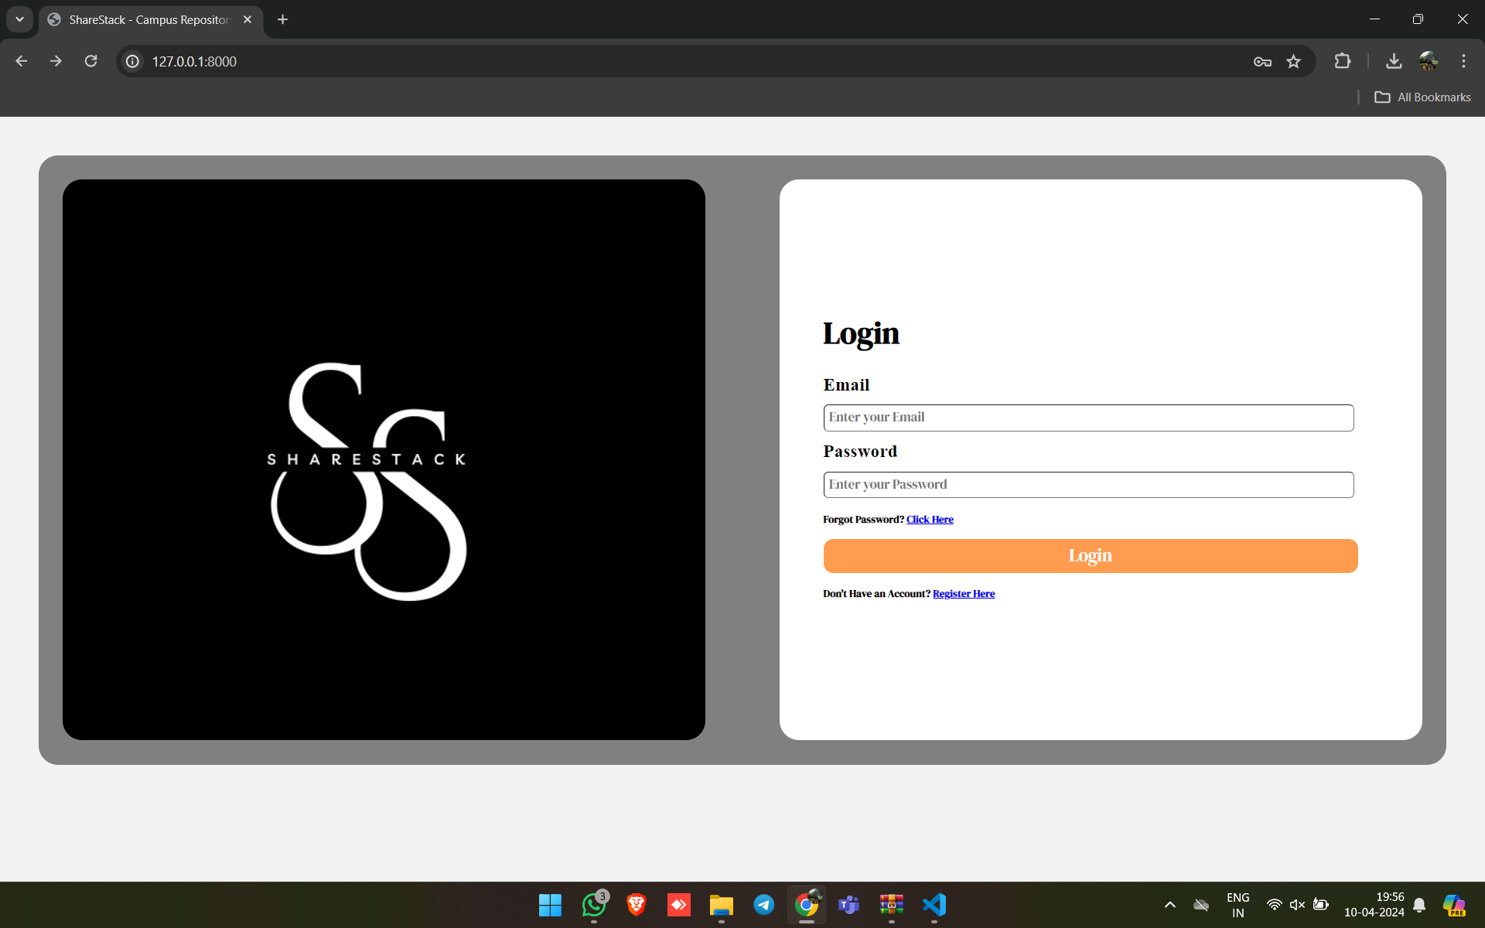
LOGIN PAGE

Slide 10
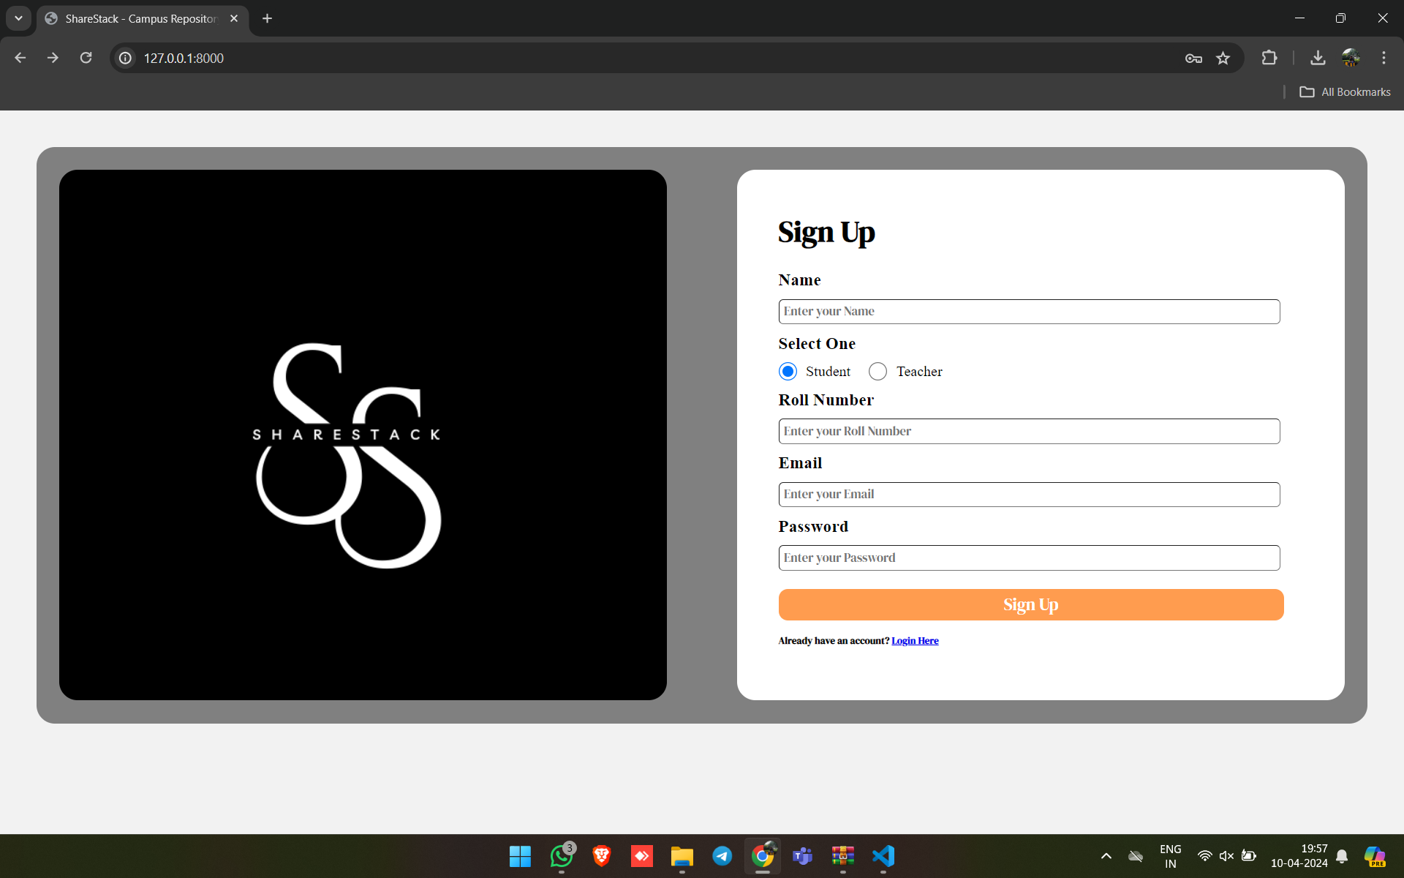
STUDENT’S LOGIN

Slide 11
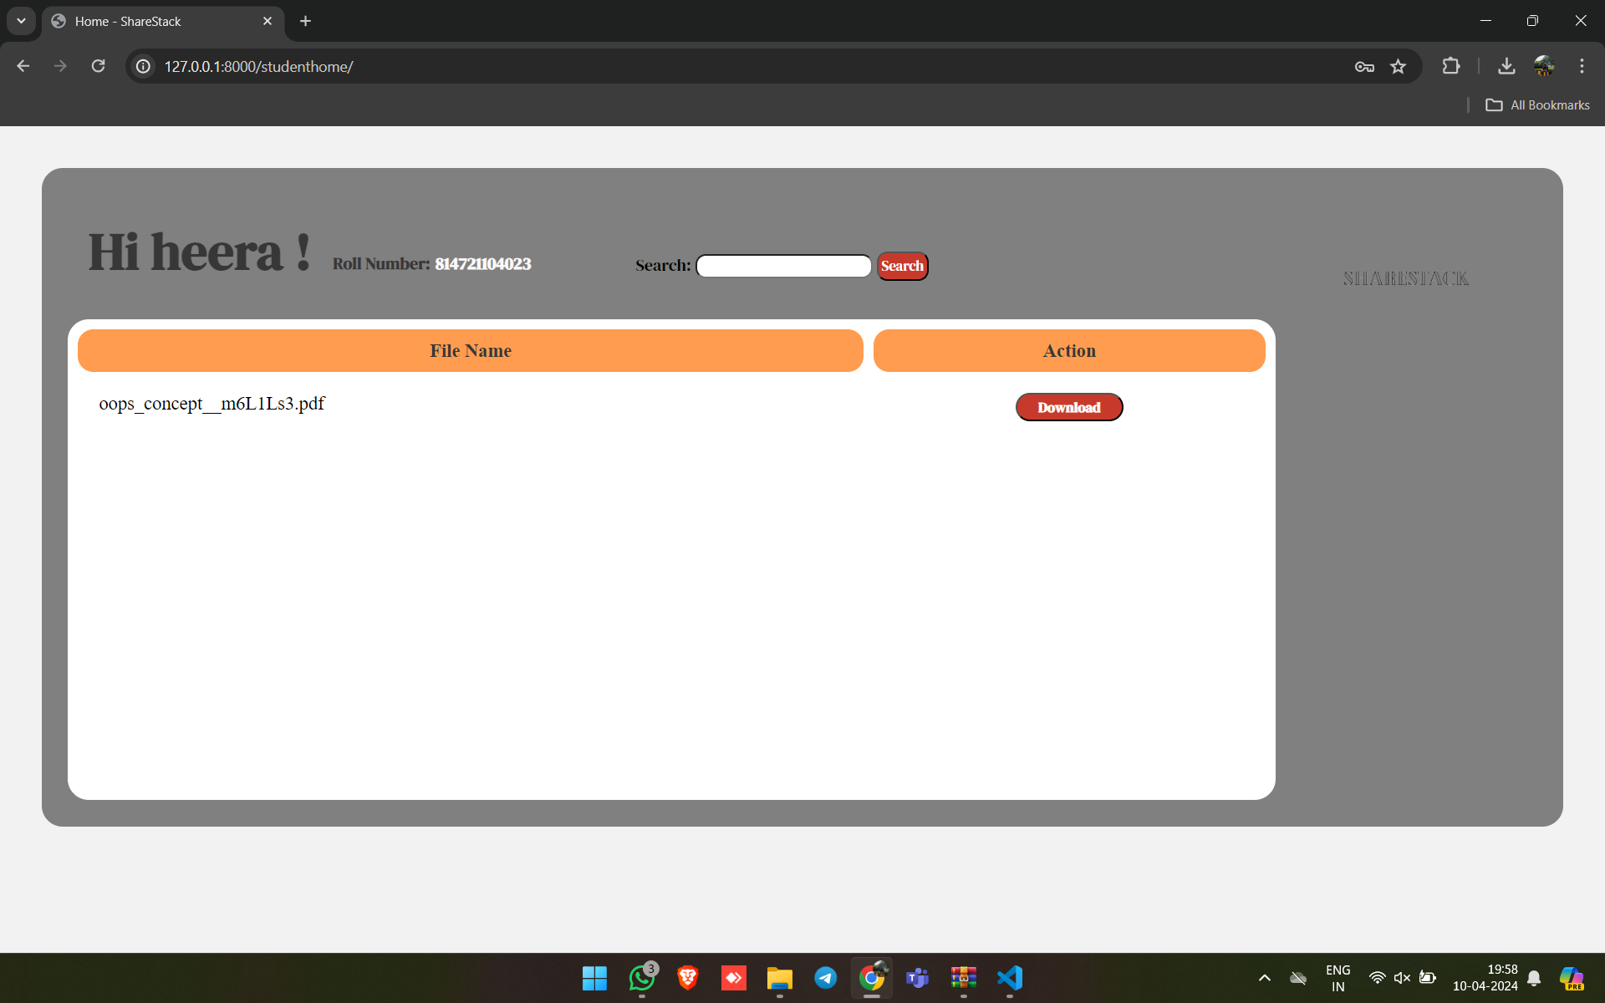
STUDENT’S PAGE

Slide 12
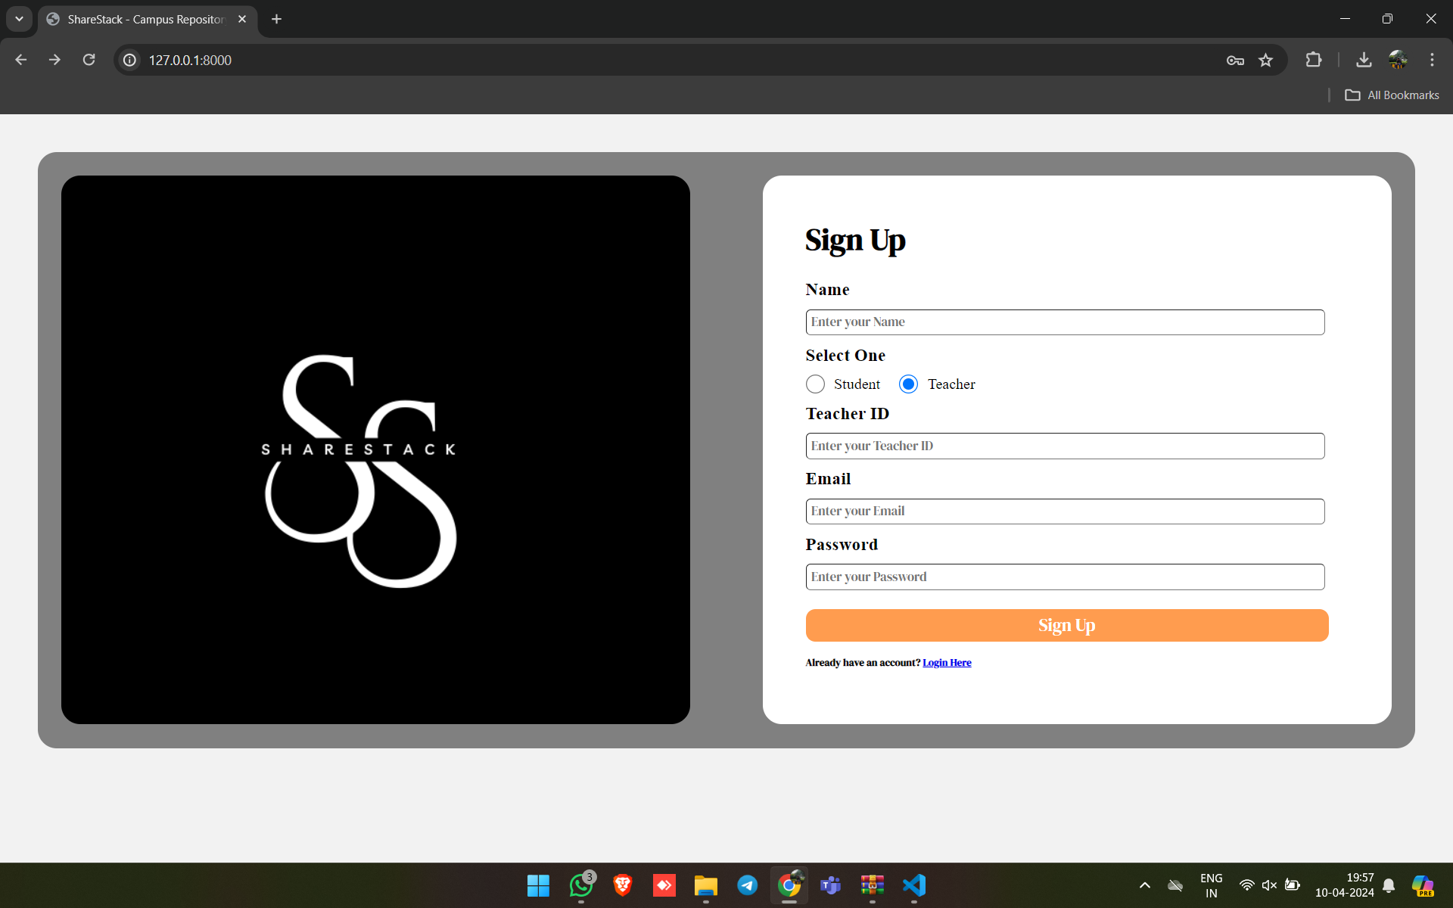
TEACHER’S LOGIN

Slide 13
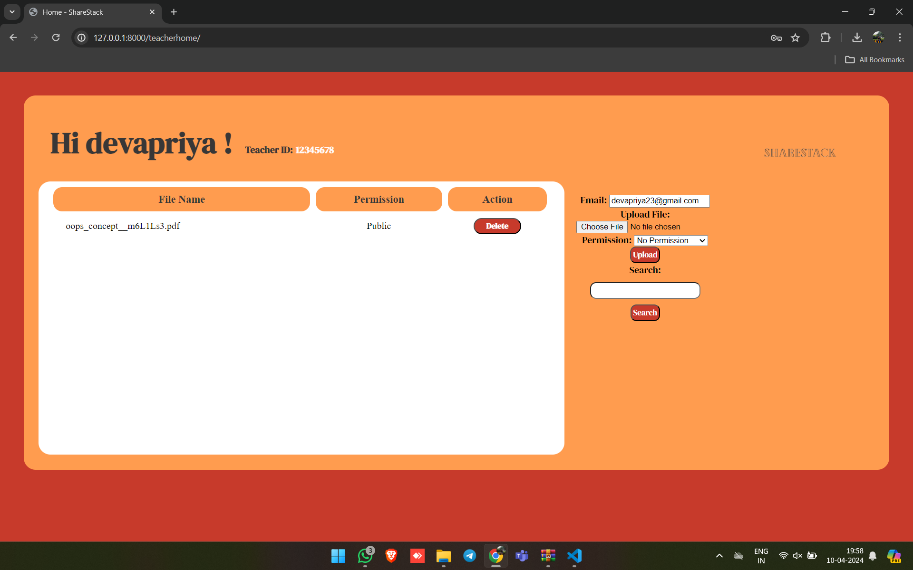
TEACHER’S PAGE

Slide 14
Future Enhancements:
In the future enhancements, several avenues can further augment the capabilities and user experience of the Notes Sharing Web Application. One significant advancement could be the integration of offline access functionality, enabling users to seamlessly work on their notes even without an internet connection. This feature would enhance productivity and ensure uninterrupted workflow, especially in areas with unreliable internet connectivity. Additionally, developing a dedicated mobile application companion would extend accessibility, allowing users to access and manage their notes on-the-go from their smartphones or tablets. Advanced collaboration features could also be introduced, such as real-time chat within the application interface and collaborative brainstorming tools, fostering more dynamic teamwork and idea generation among users. Furthermore, integrating the platform with third-party services like Google Drive or Dropbox would provide users with additional flexibility in managing their notes and attachments across different platforms. Moreover, the application could leverage machine learning algorithms to analyze note content and provide insights or suggestions to users, enhancing organization and understanding. Accessibility features, such as screen reader support and keyboard shortcuts, could also be implemented to ensure inclusivity for users with disabilities. Integration with task management tools, analytics and reporting capabilities, multi-language support, and even exploring blockchain technology for data integrity are all promising directions for future enhancements, aiming to enrich the user experience and utility of the Notes Sharing Web Application.

Slide 15
Conclusion
In conclusion, the development of the Notes Sharing Web Application using Django Framework offers a robust solution to streamline note-taking and collaboration processes for individuals and teams. By leveraging Django's features and incorporating advanced functionalities such as real-time collaboration, version control, and advanced search, the application provides users with a powerful platform to enhance productivity and foster teamwork. The proposed solution prioritizes user data privacy and security while offering a user-friendly interface and customizable organization options. However, the journey doesn't end here. Future enhancements such as offline access, mobile application development, advanced collaboration features, and integration with third-party services hold the potential to further elevate the application's capabilities and user experience. With continuous innovation and adaptation to evolving user needs, the Notes Sharing Web Application is poised to become an indispensable tool for efficient knowledge sharing and collaboration in the digital age.

Slide 16
Thank You!
Notes:
Thank You !!

